Slide 1

Comprehensive SEO Audit & Optimization for Organic Traffic Growth

Slide 2
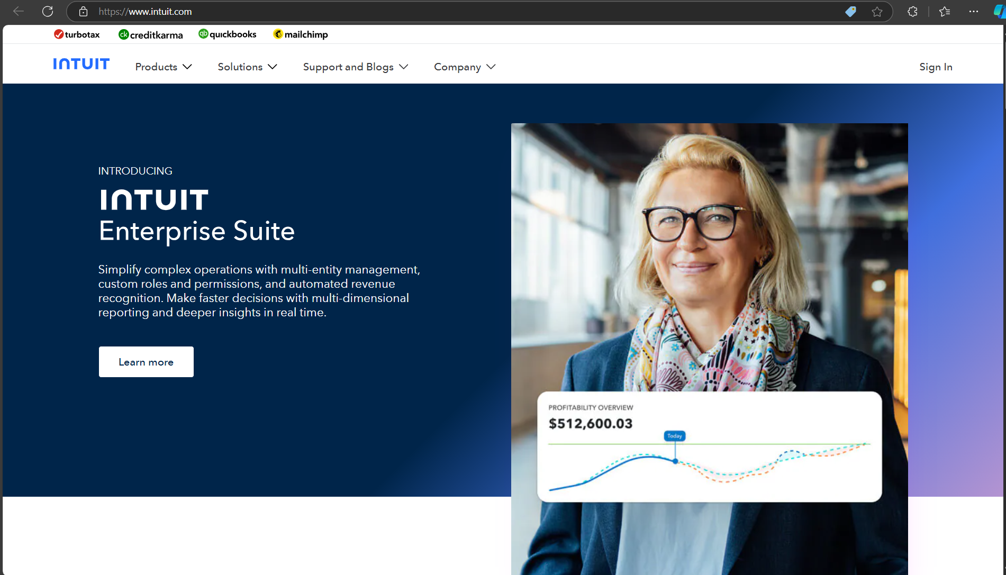
Comprehensive SEO Audit & Optimization for Organic Traffic Growth
Company Selected: Intuit
Website: Intuit®: Complete Financial Confidence

Slide 3
Company Description
Intuit is a financial software company that specializes in developing software and services for small businesses, accountants, and individuals.
Founded in 1983, the company is best known for its flagship products that aim to simplify financial management and tax preparation.
Intuit serves various markets, including small businesses, the self-employed, and individual consumers.
Their services are heavily integrated with AI to enhance user experiences and automate complex tasks.
The company’s performance has been robust, reporting substantial growth in revenue and expanding its offerings globally.

Slide 4

Company Description
Key Products:
QuickBooks
TurboTax
Credit Karma
Mailchimp

Slide 5
Task 1 - Initial SEO Audit for Intuit.com
Current Performance Overview:
Overall Site Score: 65/100 (Fair)
Desktop Performance: 34/100 (Poor)
Mobile Performance: 6/100 (Critical)
Strengths:
SEO Standards Compliance (13/22 categories met)
Meta Tags and URL
Mobile Optimization
Keyword Usage

Slide 6
Initial SEO Audit for Intuit.com
Weaknesses:
Critical Issues (8/22 Categories Not Met):
Accessibility:
Missing accessible names for buttons.
Lack of alt text for some images.
Meta Descriptions: Inconsistent or missing meta descriptions that could improve click-through rates from search engine results.
Performance:
Desktop Load Time: Score of 34/100
Mobile Performance: Critical score of 6/100
Advanced SEO:
Schema Markup: Minimal usage of schema markup, which limits visibility in search engine rich results.

Slide 7
Task 2 - Keyword Research Findings
 | Keyword | Search Volume | Competition
1 | Intuit QuickBooks | 10k-100k | Medium
2 | Intuit | 10k-100k | Medium
3 | Intuit Mailchimp | 10k-100k | Low
4 | Intuit proconnect | 10k-100k | Low
5 | QuickBooks | 10k-100k | Medium
Competitors like H&R Block and FreshBooks target:
“TurboTax alternatives”
“Best accounting software for small businesses”
Importance of positioning Intuit products (QuickBooks, TurboTax) as superior solutions for niche audiences.
Target long-tail keywords such as:
“QuickBooks for freelancers”
“Affordable tax software for small businesses”

Slide 8
Task 3 -On-Page SEO Optimization Audit
Page 1: Intuit Home Page
Title Tags
Current Title: "Intuit®: Complete Financial Confidence“
Character Count: 38 characters
Status: Not optimized
Analysis: The title is concise, mentions the brand, and provides a clear value proposition. However, it lacks relevant target keywords related to financial software, taxes, or accounting.
Meta Descriptions
Current Meta Description: "See how Intuit products can work for you by joining the approximately 100 million people who are already using TurboTax, Credit Karma, QuickBooks, and Mailchimp to power their prosperity.“
Character Count: 187 characters (too long)
Status: Not optimized
Analysis: This description highlights the product range and user base but exceeds the recommended length. It can be more concise and focused on action.
HTML Tags
Current Status: Missing H1 tag, no clear heading structure
Analysis: The page lacks structured HTML headings, which impacts both SEO and accessibility.
Keyword Usage in Content
Current Status: Partially optimized
Analysis: Keywords like "financial confidence," "TurboTax," and "QuickBooks" are present but could be used more strategically.
Internal and External Linking
Current External Links: 3 external links
Image Optimization
Current Status: All images have alt texts but could benefit from more descriptive file names.

Slide 9
On-Page SEO Optimization Audit
Page 2: Intuit for Education
Title Tags
Current Title: "Intuit for Education | The financial literacy education platform
Character Count: 64 characters
Status: Partially optimized
Meta Descriptions
Current Meta Description: "Discover how Intuit’s financial education resources set students up for future financial success.“
Character Count: 97 characters
Status: Not optimized
HTML Tags
Current Status: Lacks clear heading structure (no H1 or H2)
Recommendations:
Add an H1: "Empowering Students with Financial Literacy“
Use H2 tags for educational programs and tools.
Keyword usage in content
Current Status: Partially optimized
Recommendations:
Use keywords like “financial literacy,” “educational resources,” and “student success” in headings and content.
Internal and External Linking
Current External Links: 7 external links
Recommendations:
Ensure links are to authoritative educational resources.
Add contextual internal links to other educational products.
Image Optimization
Current Status: 3 images missing alt attributes
Recommendations:
Add alt text for all images (e.g., "students using financial literacy tools").
Ensure file names are descriptive (e.g., "financial-literacy-education.jpg").

Slide 10
On-Page SEO Optimization Audit
Page 3: TurboTax
Title Tags
Current Title: "Intuit®: Complete Financial Confidence“
Character Count: 38 characters
Status: Partially optimized
Meta Descriptions
Current Meta Description: "See how Intuit products can work for you by joining the approximately 100 million people who are already using TurboTax, Credit Karma, QuickBooks, and Mailchimp to power their prosperity.“
Character Count: 187 characters
Status: Not optimized
HTML Tags
Current Status: No clear H1 tag
Keyword Usage in Content
Current Status: Well-optimized but could benefit from additional keyword variety.
Recommendations:
Add keywords like “tax filing software,” “tax return,” and “small business taxes.”
Internal and External Linking
Current External Links: 3 external links
Recommendations:
Ensure external links are authoritative and relevant (e.g., IRS website).
Add more internal links to other TurboTax features.
Image Optimization
Current Status: Alt texts present, but file names could be more descriptive.
Recommendations:
Use descriptive file names (e.g., "turbotax-tax-filing.jpg").
Ensure all alt texts include relevant keywords.

Slide 11
Task 4 - Technical SEO Status Analysis
Analysis of Current Technical SEO Status
Technical SEO Improvements Needed
Title & Meta Descriptions: lack optimization
Missing H1 & H2 Tags
Page Load Speed: Slower than recommended standards
Technical SEO Issues on Homepage and 3 Web Pages
Homepage:
No H1 tags present.
Meta description exceeds the recommended length and lacks relevant keywords.
Open Graph tags are absent.
Web Page 1:
Images lack descriptive, keyword-rich file names.
Duplicate Open Graph meta tags.
No structured data (Schema.org) implemented.
Web Page 2:
Slow page load times due to maximized CSS and JavaScript.
No caching solution in place.
Inconsistent URL structure (www and non-www versions not redirected).
Web Page 3:
High number of HTTP requests.
Missing H2 tags in subheadings.
Non-optimized image file sizes.

Slide 12
Five Best Practices to Improve Site and Page Speed
Optimize Images:
Compress images and use modern formats like WebP.
Minify CSS, JavaScript, and HTML:
Reduce file size to improve loading times.
Leverage Browser Caching:
Store frequently used files in users' browsers for faster repeat visits.
Use a CDN (Content Delivery Network):
Improve load speed globally by distributing content across multiple servers.
Reduce HTTP Requests:
Minimize the number of page elements like scripts and images to reduce loading time.

Slide 13
Task 5 - Content Strategy Plan Based on Keyword Research
Goal
Enhance search visibility and customer engagement through strategic content efforts.
Target Keywords
Primary Keywords: Financial software, tax solutions, small business accounting
Secondary Keywords: Financial confidence, tax filing software, budgeting tools
Content Creation
Blog Posts & Articles: Topics: "Using Financial Software for Small Businesses," "Top Tax Solutions"
Product Pages: Optimize with relevant keywords and H1, H2 tags
FAQs & Guides: Create keyword-rich, detailed guides for customer education

Slide 14
Content Strategy Plan Based on Keyword Research
Optimization Focus
Keyword Integration
Heading Structure
Internal & External Linking
Content Calendar
Establish a consistent publishing schedule (e.g., weekly blog posts, seasonal content)
Performance Tracking
Monitor KPIs
Adjust content based on keyword rankings and user behavior insights

Slide 15
Task 6 – Off Page SEO Plan & Strategy for Intuit
Backlink Building
Target High-Authority Sites
Collaborate with Educational Institutions
Content Marketing
Create Shareable Resources
Leverage Social Media
Influencer Marketing
Engage Finance Influencers

Slide 16
Off Page SEO Plan & Strategy for Intuit
Social Media Engagement
Build a Community
Local SEO & Listings
Optimize Google My Business: Update and encourage customer reviews to boost local visibility.
Get Listed on Directories
Implementation Timeline
Short-term (1-3 months): Backlink outreach, content marketing.
Medium-term (3-6 months): Influencer marketing, social media engagement.
Long-term (6-12 months): Track results and optimize strategies.

Slide 17
Conclusion
Successful SEO Audit
Targeted Keyword Research
On-Page and Technical Improvements
Robust Content Strategy
Strategic Off-Page SEO Planning
Foundation for Growth
Long-Term Success Preparedness

Slide 18
Thank
thank
Thank
You
You
You
you
Thank you

